Slide 1
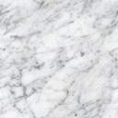
Spliceome dynamics during osteogenesis
Part 2: Functional consequences of alternative splicing (RNA-Seq)
Angel Liang
7/4/2020

Slide 2
Specificity of AS targets - multifaceted
1. Does AS regulate certain pathways? |  | Strategy: KEGG/reactome pathway enrichment
2. Does AS regulate certain domains? |  | Strategy: PFAM enrichment
3. Is AS driven by a network of upstream SFs? |  | Strategy: Upstream RBP enrichment
3. Are only certain proteins spliced? |  | Currently looking at (in decreasing order of urgency): phenotypic targets e.g. lysosome, ER stress, Ca²⁺/H⁺ transporters, mechanosensitive ion channels kinases, | spliceosome components, transcription factors/co-factors, Liquid-liquid Phase Separation (LLPS) orchestrators/prion-like proteins, histone modifiers/chromatin remodelers, lncRNAs
4. Does AS regulate upstream SFs themselves? |  | Strategy: clustering
4. Which portions of transcripts are regulated? |  | protein coding? Non-coding?... CDS, 5' UTR, 3' UTR?… induces NMD?... protein domains, LCRs, IDRs, phosphosites?...

Slide 3
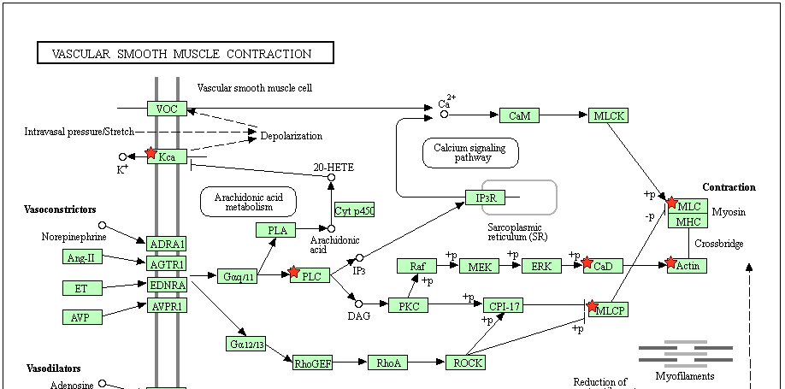
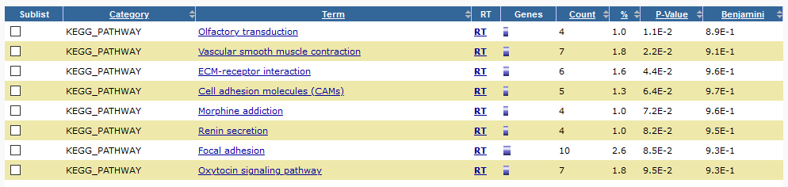
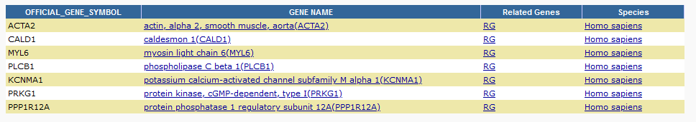
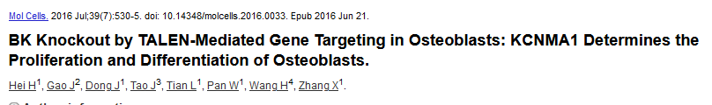
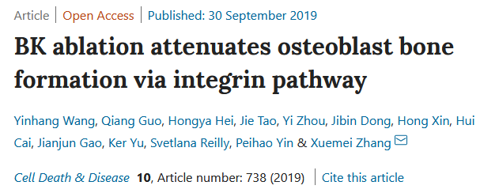
A first look at the data: JUM
398 genes with AS between first/last timepoints
KEGG pathways enriched:
Kinetics of KCNMA1 channels are determined by [intracellular calcium status,] alternative splicing, phosphorylation status and its combination with modulating beta subunits. (Genetics Home Reference, NIH)

Slide 4
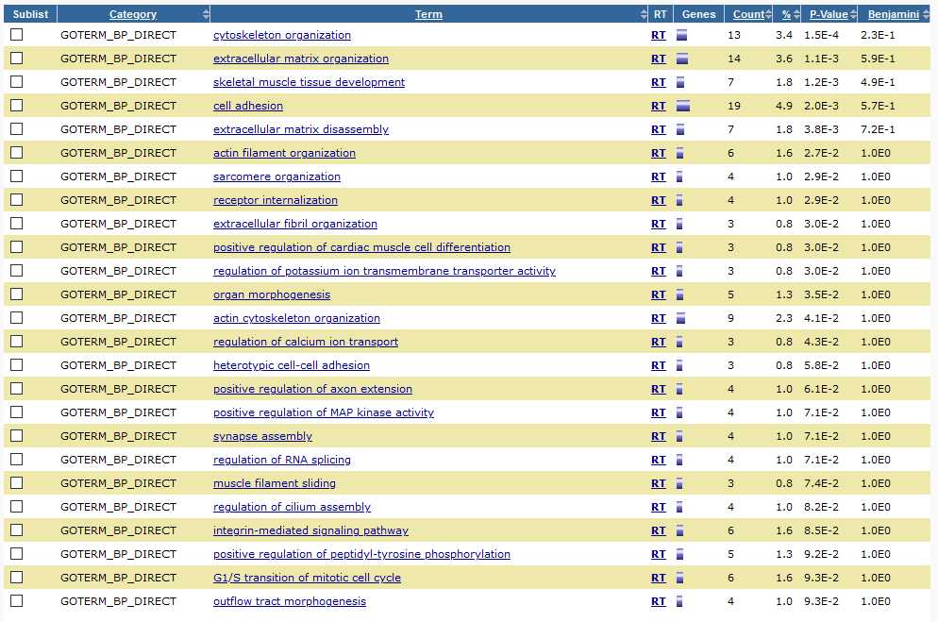
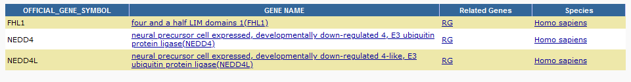
A first look at the data: JUM
398 genes with AS between first/last timepoints
BP GO term:

Slide 5
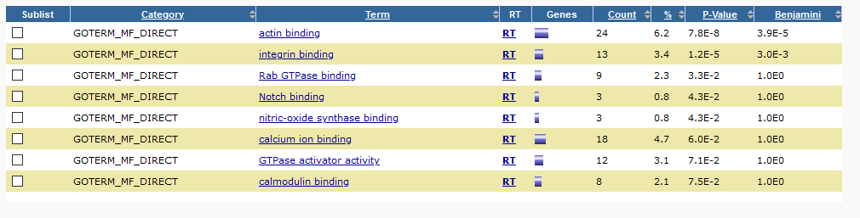
A first look at the data: JUM
398 genes with AS between first/last timepoints
MF GO term:

Slide 6
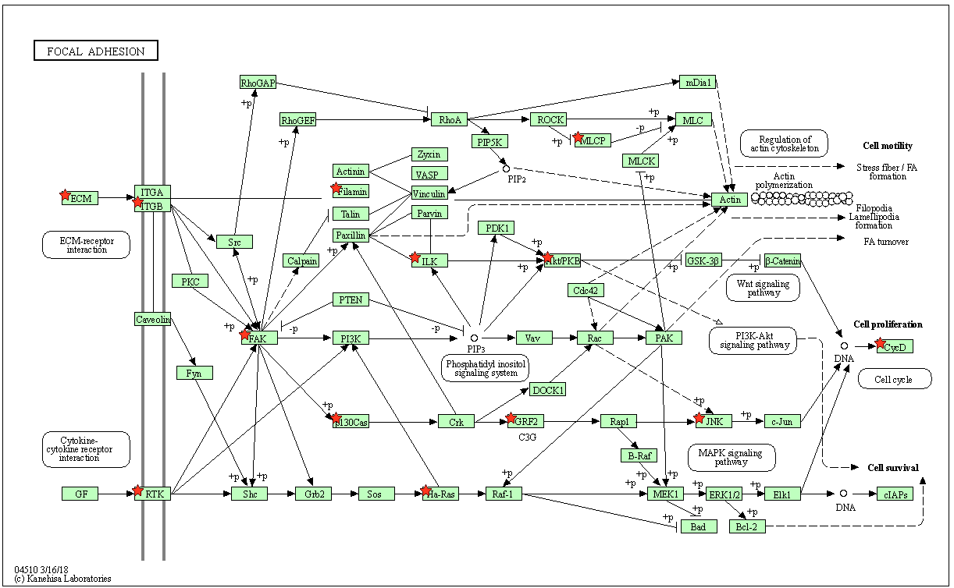
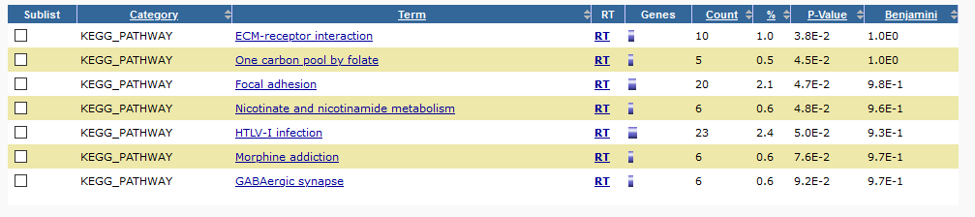
A first look at the data: JUM
983 genes with differential AS (any significant pairwise change)
KEGG pathways:
Focal adhesion/cytoskeletal components clearly important
Deep connections with mechanosensing machinery, regulated by AS.
AS seems to often occur in kinases

Slide 7
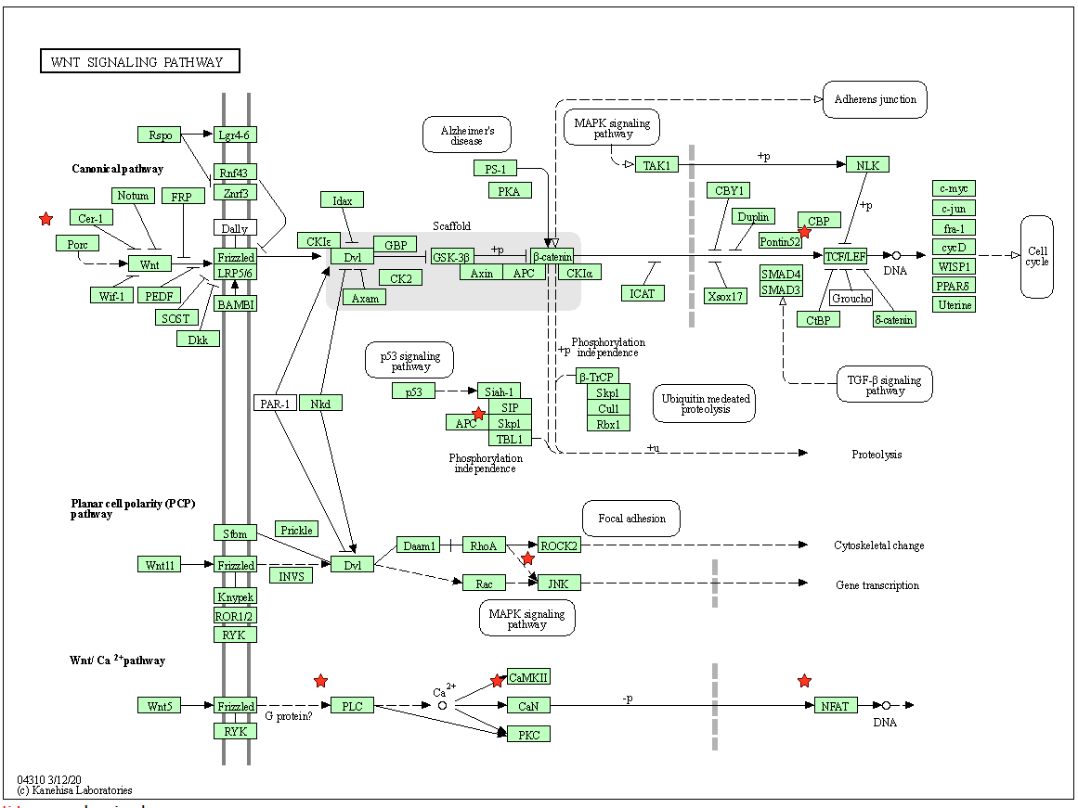
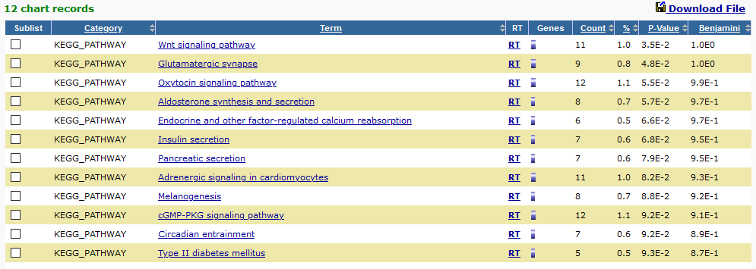
A first look at the data: PSI-Sigma
??? genes with AS between first and last time point
KEGG pathway enriched for Wnt signaling – a good sign
Mostly transcription factors TCF7/7L2, NFATC1/3/4

Slide 8
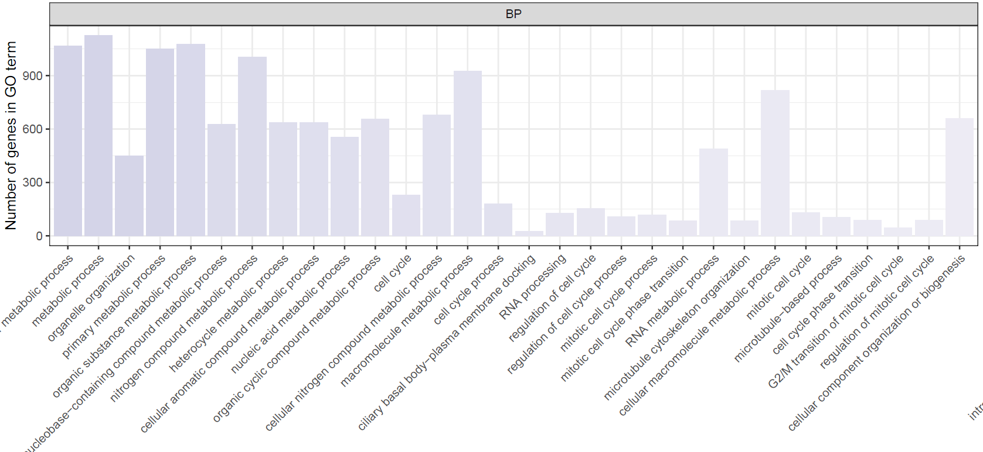
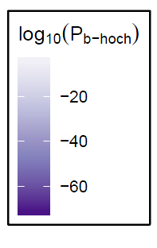
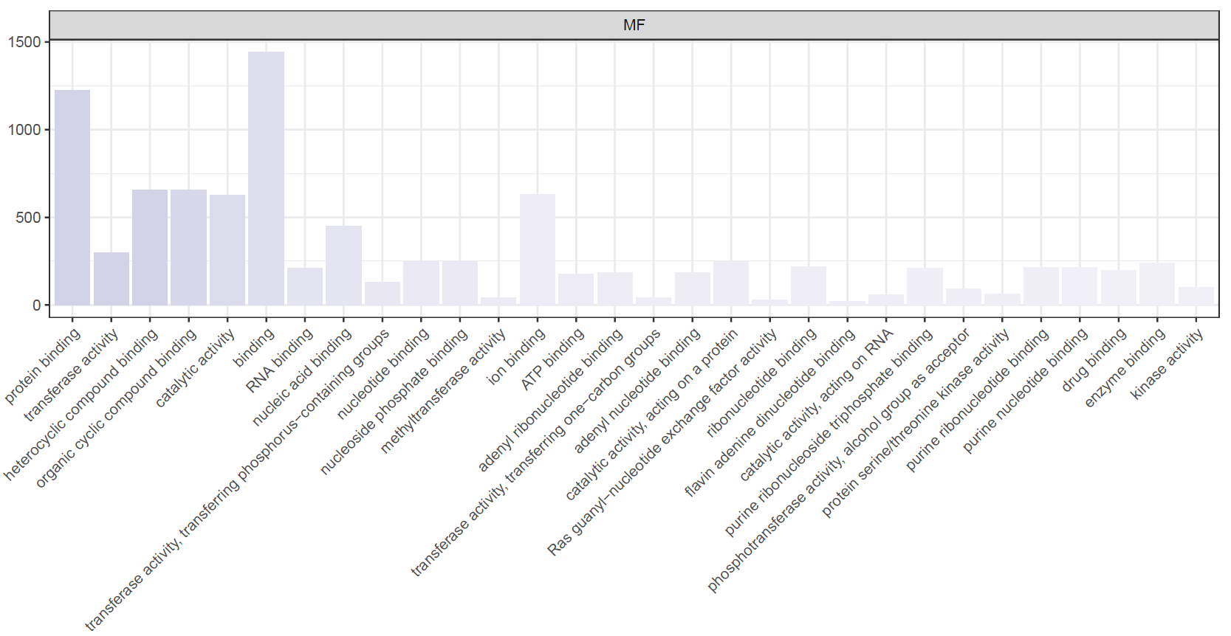
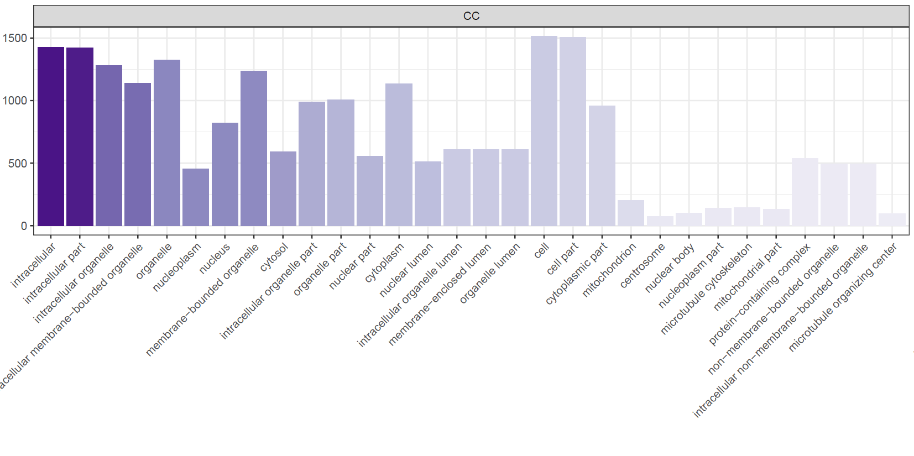
A first look at the data: PSI-Sigma
Top 30 GO Term enrichment for all 1899 genes differentially spliced

Slide 9
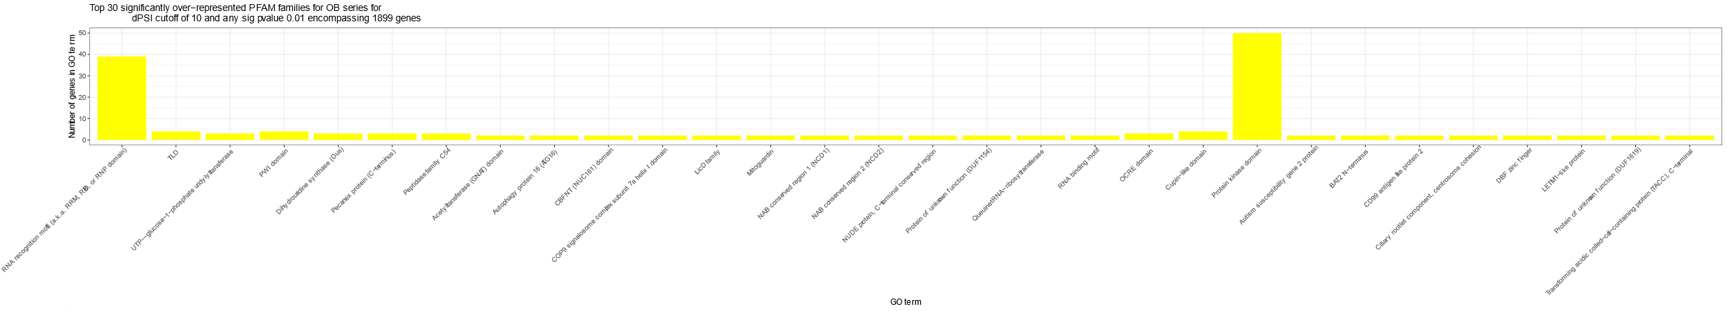
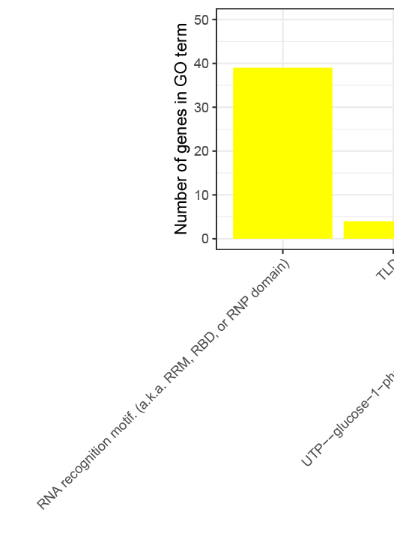
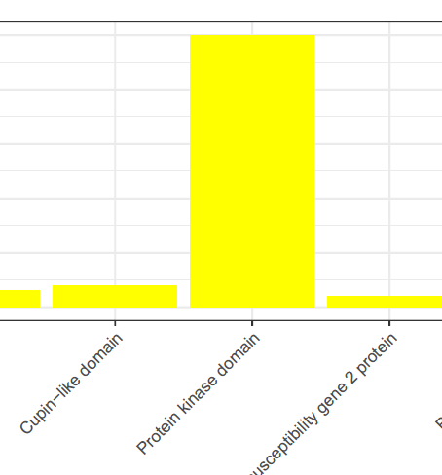
A first look at the data: PSI-Sigma
Top 30 PFAM family enrichment for all 1899 genes differentially spliced

Slide 10
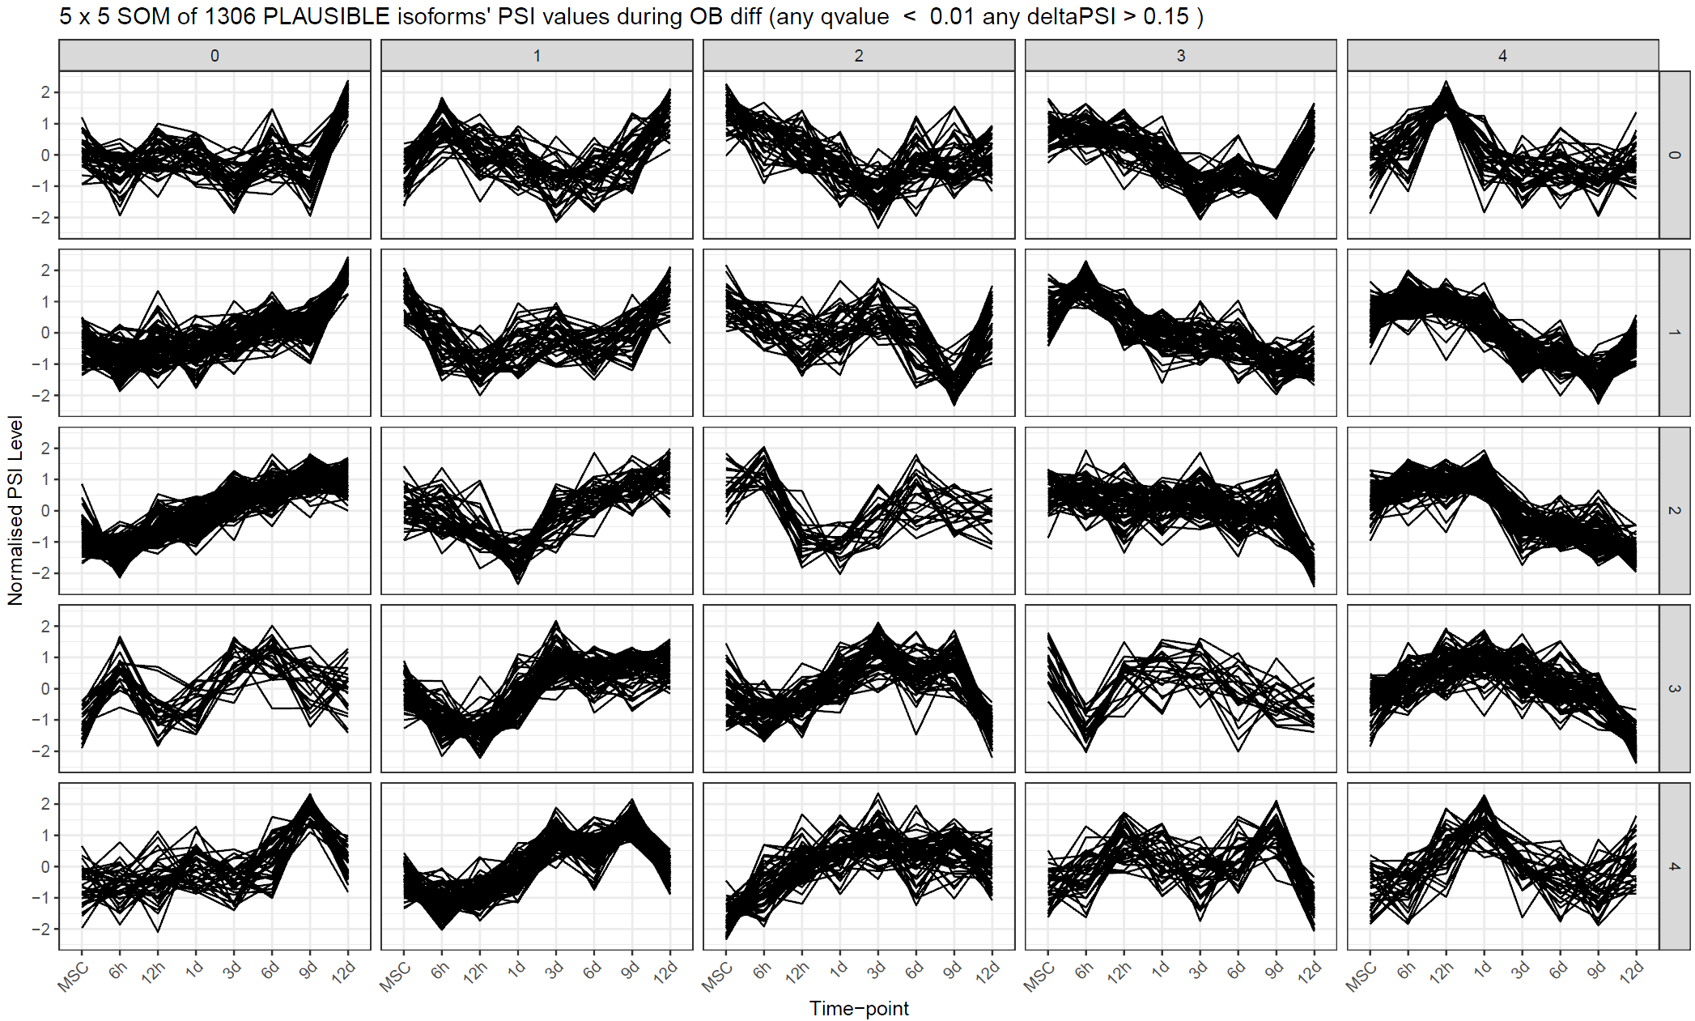
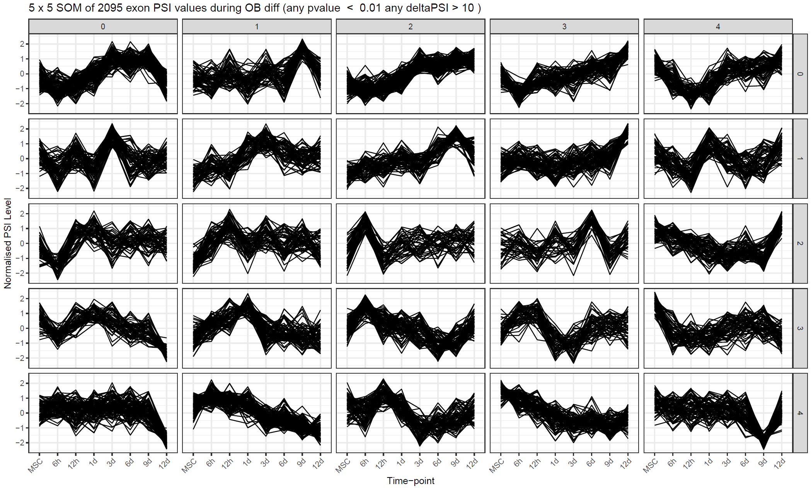
Clustering of time-series spliceomic data
Kohonen SOM
Map dimensions set to 5x5 at this point
JUM:
Differential junctions (all)
Differential junctions (plausible only)
PSI-Sigma:
Differential LSVs
Differential exons (sum of all LSVs)

Slide 11
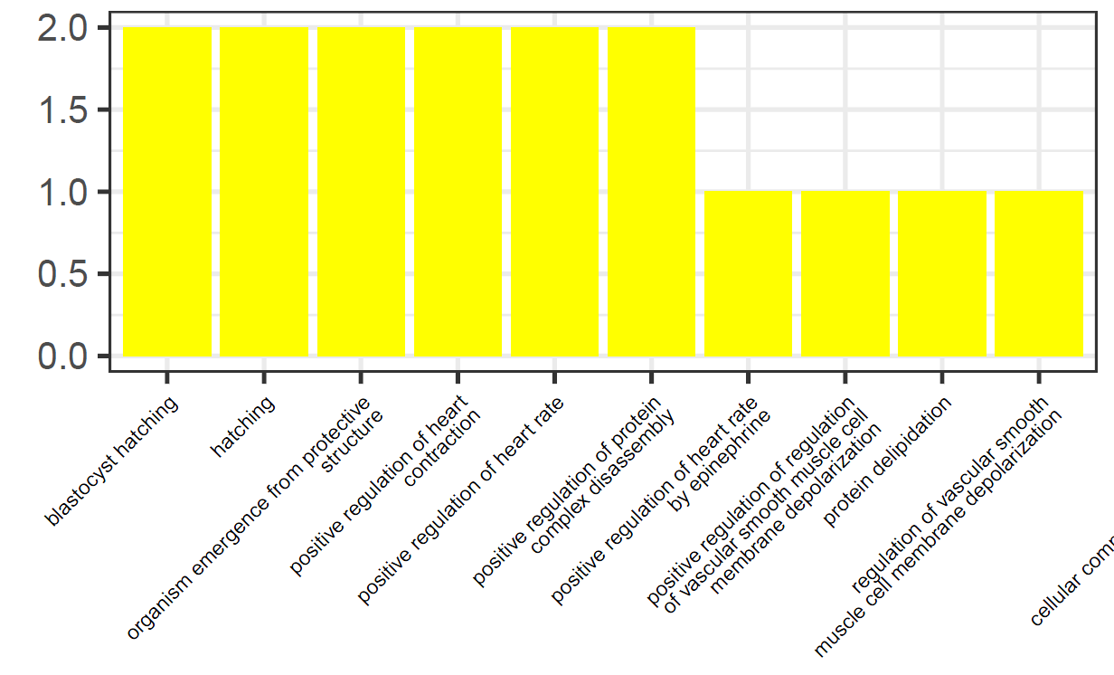
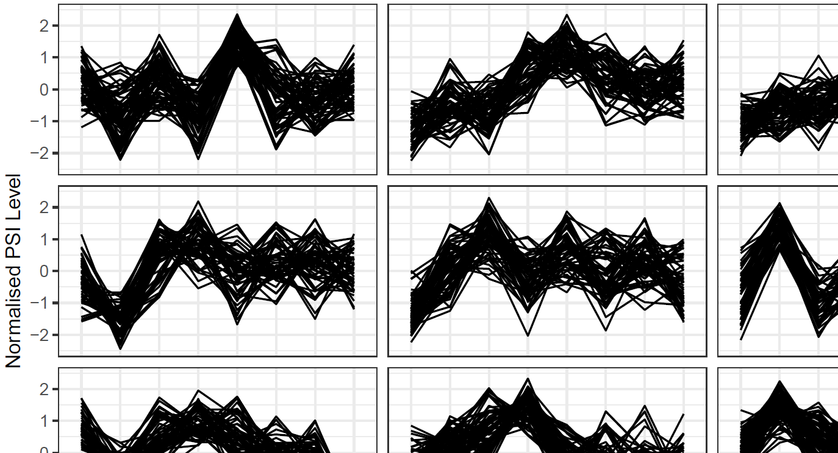
Functional enrichment
GO Terms and PFAM families for ALL genes containing differential junctions/exons
For clustered junctions/exons, functional enrichment done:
GO Terms (each cluster)
PFAM families (each cluster)
Upstream RNA-binding proteins (from CLiP-Seq, FLASH-Seq)
Analyses repeated for the highest/lowest scaled PSI at each time point

Slide 12
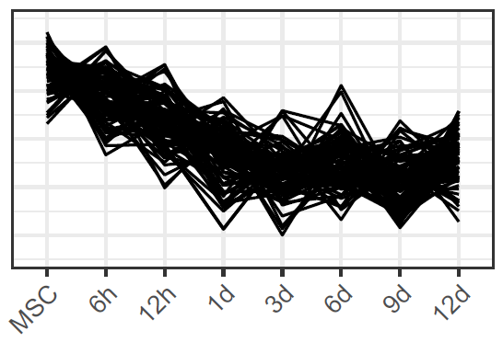
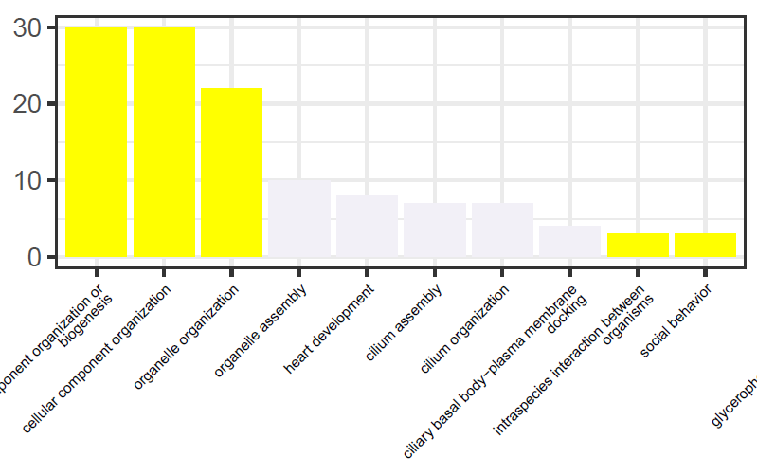
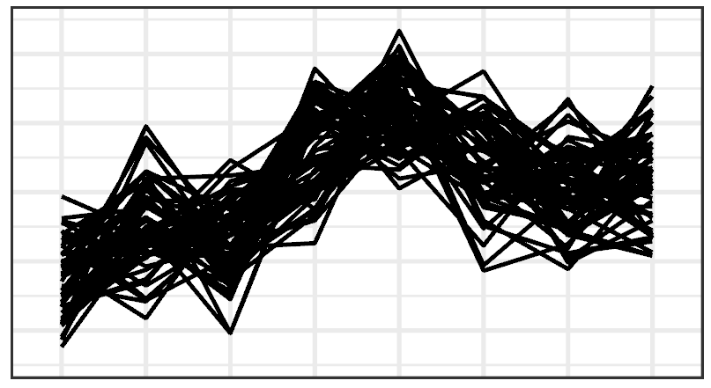
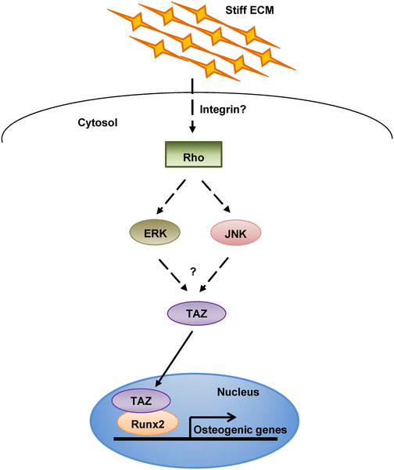
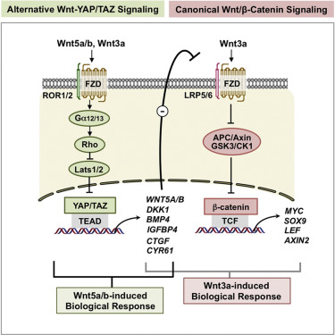
Cluster-wise GO terms of interest - PSI-Sigma
?????
CACNA1C, CACNB3, Notch pathway, ATXN2L (an SF)
BP
YAP1, TAZ, TPM1, GALNT11, ANK2, LTBP1, ARL13B, ADAM15
Park, H.W., Kim, Y.C., Yu, B., Moroishi, T., Mo, J.S., Plouffe, S.W., Meng, Z., Lin, K.C., Yu, F.X., Alexander, C.M. and Wang, C.Y., 2015. Alternative Wnt signaling activates YAP/TAZ. Cell, 162(4), pp.780-794.
Hippo pathway mediates mechanosensitive differentiation mechanisms
Also transcriptionally interacts with Wnt signalling
Hwang, J.H., Byun, M.R., Kim, A.R., Kim, K.M., Cho, H.J., Lee, Y.H., Kim, J., Jeong, M.G., Hwang, E.S. and Hong, J.H., 2015. Extracellular matrix stiffness regulates osteogenic differentiation through MAPK activation. PloS one, 10(8).

Slide 13
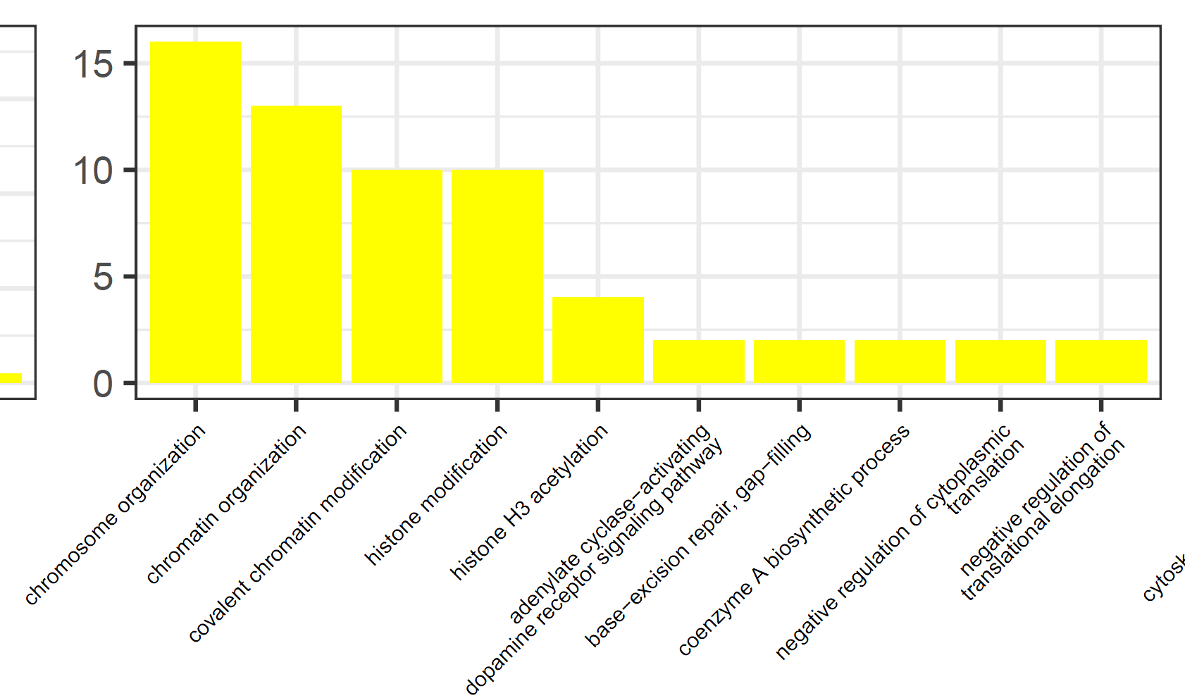
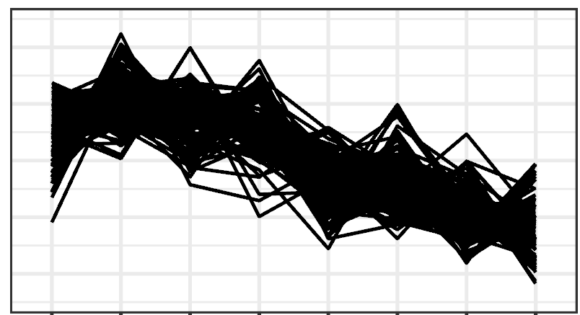
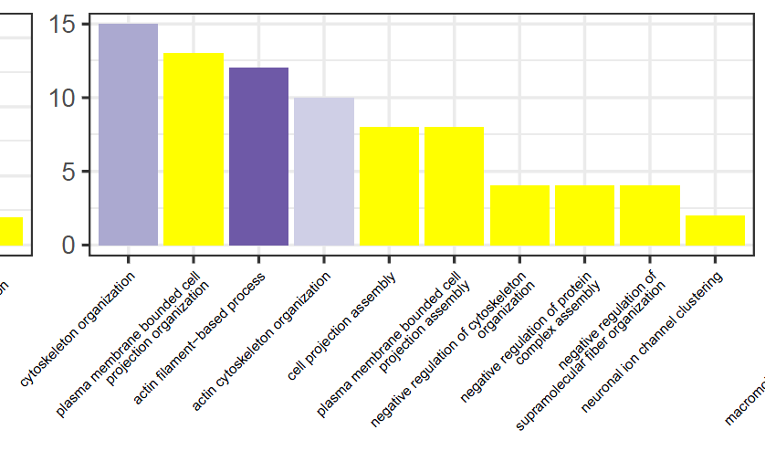
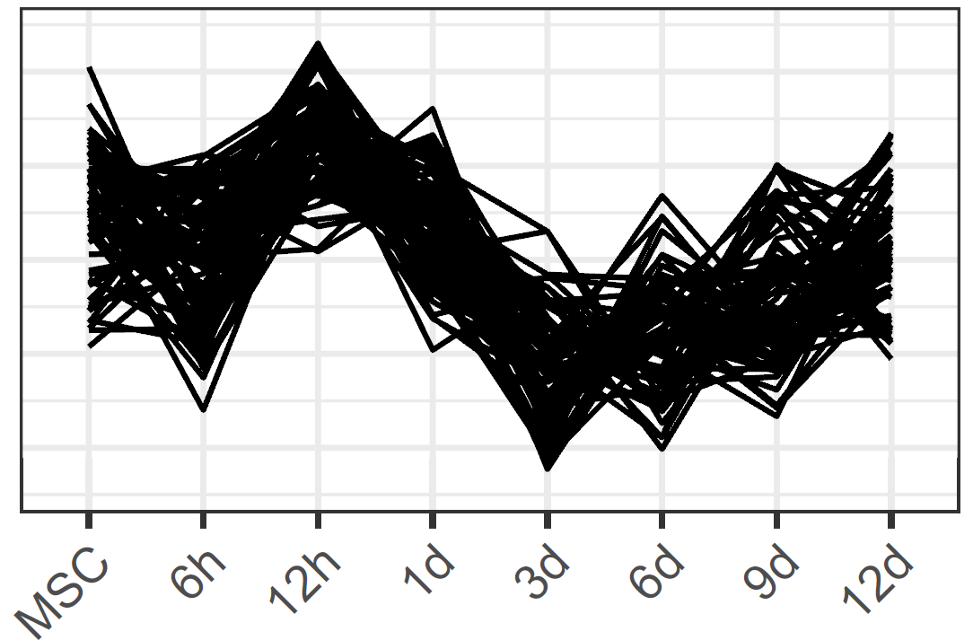
Cluster-wise GO terms of interest - PSI-Sigma
BP
SMARCB1, ARID2 … form the BAF (mammalian SWI/SNF) complex
BRPF1 positively regulates RUNX2
SMARCB1, BRPF1, ARID2, NAA60, UBR2, UBE2A, MTF2, PHC1, FMR1, SGF29, NTMT1
POLB, POLD1
BP

Slide 14
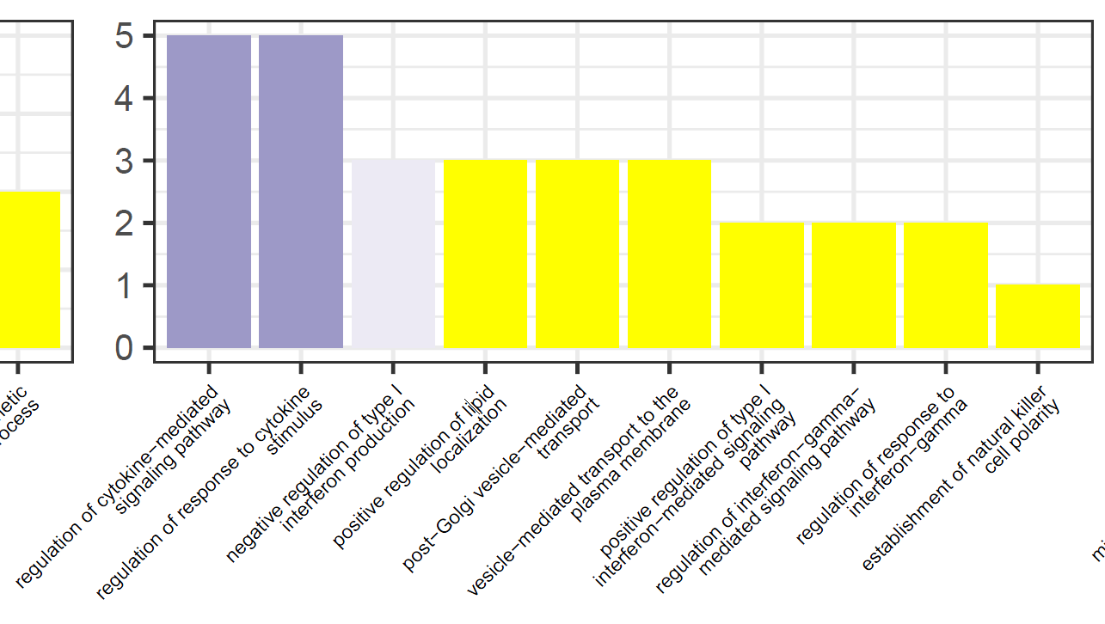
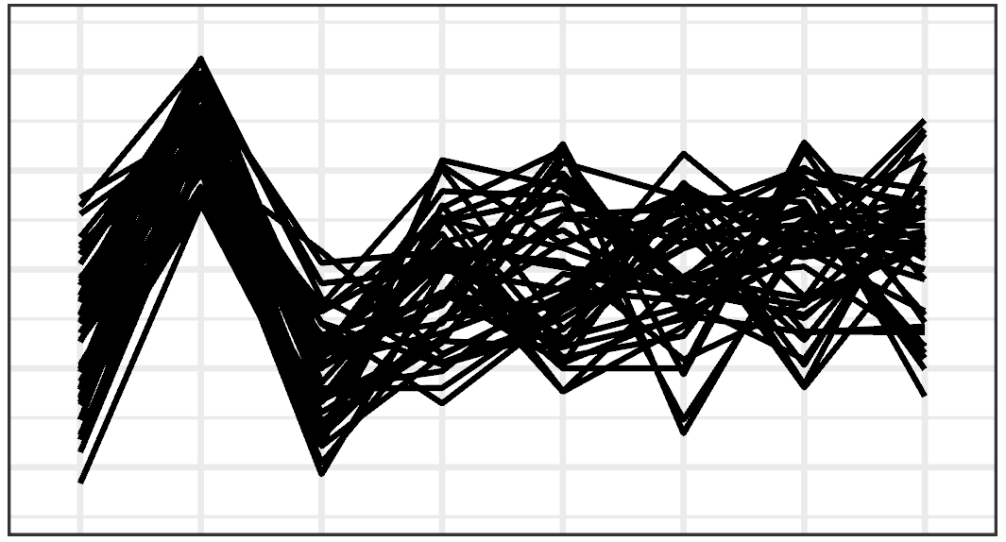
Cluster-wise GO terms of interest - PSI-Sigma
VRK2, NR1H3, NLRC5, IKBKE, CYLD
BP
!!
Cellular stress is important for the adaptation of osteoblasts to the mineralization phenotype.
Whether NF-κB directly upregulates the stress response or co-operates with RUNX2 is unclear.
Lysosomal trafficking via ER/golgi is the mechanism of mineralization.
This evidence possibly reflects concerted regulation by AS.

Slide 15
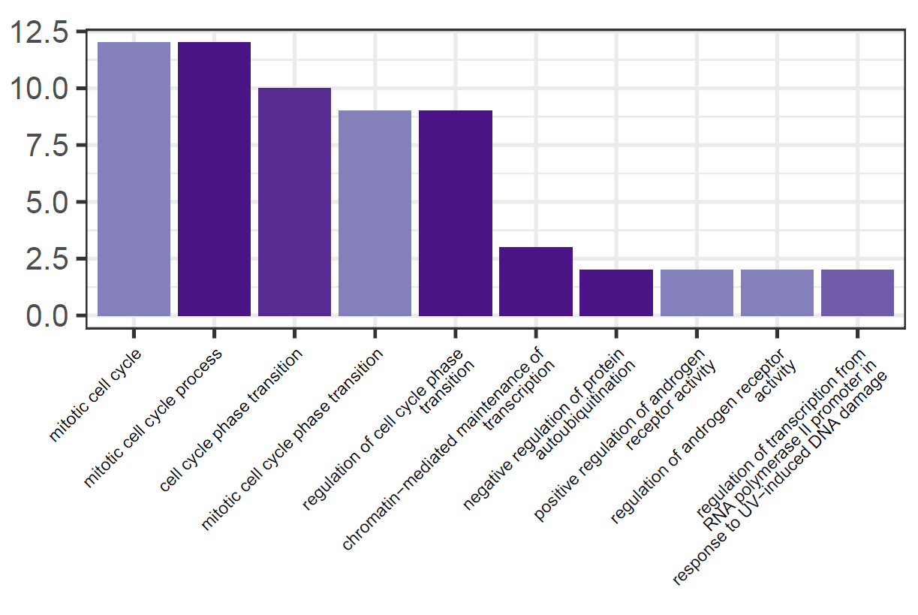
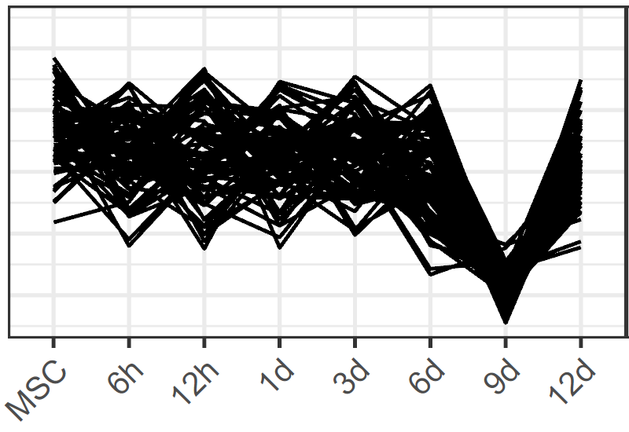
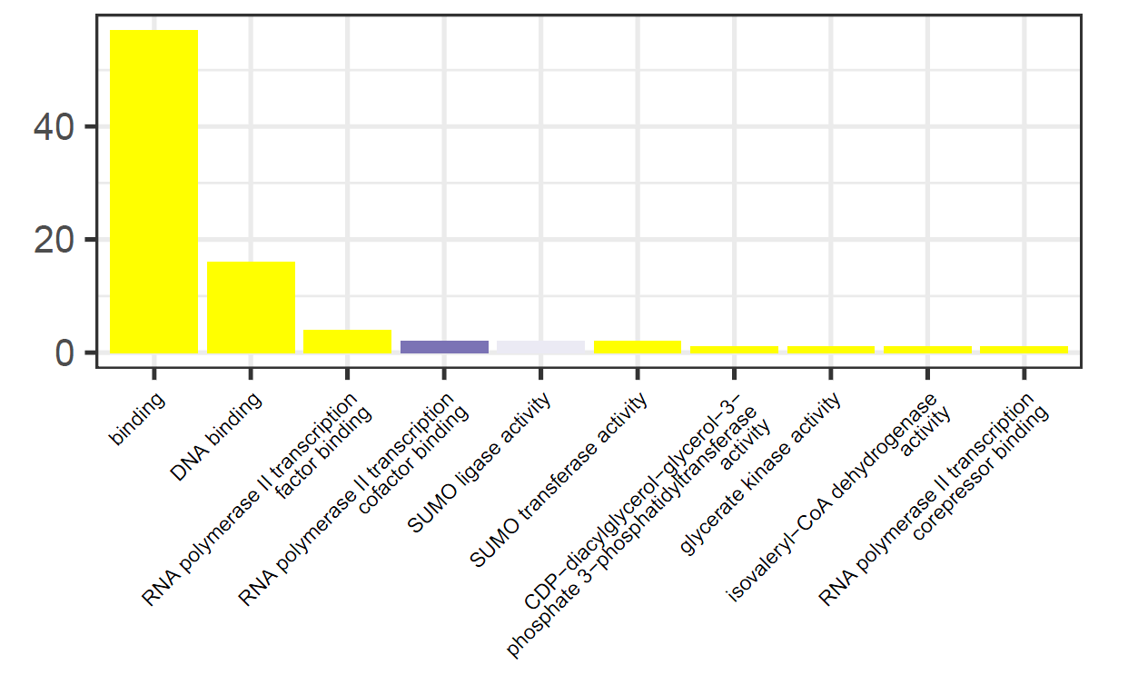
Cluster-wise GO terms of interest - PSI-Sigma
BP
MF

Slide 16
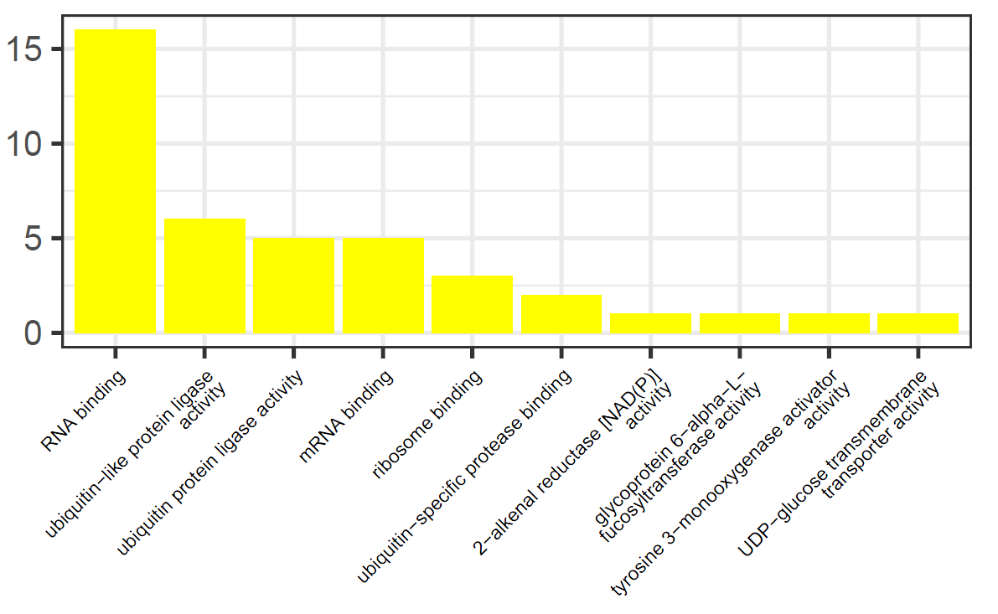
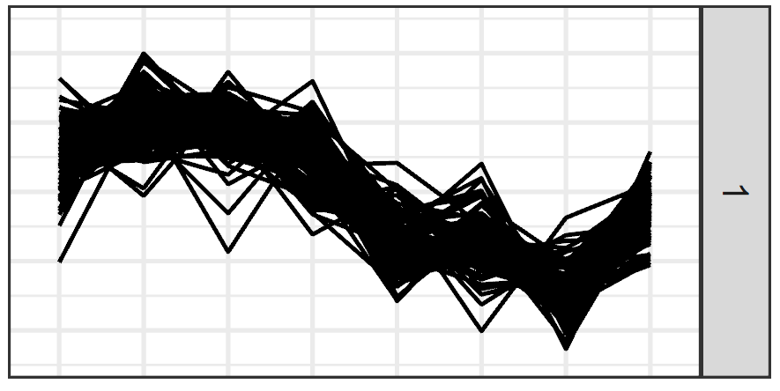
Cluster-wise GO terms of interest – JUM (plausible only)
MF
MBNL1, SRRM2, SRPK2, PARK7, RPL17, UBE2O, DDX39A, DZIP3, FMR1, TNRC6A, UBAP2L, FNDC3A, ZC3H11A, RPLP0, EIF4H, THOC5

Slide 17
Recurring genes of interest - JUM
SRSF11
MACF1
MBNL1
SRRM2
WNK1
ILK
SRSF2/6
SRSF6
SRSF6
ATXN2L
SRSF11
SRSF3
SRSF11
SRSF11
ATXN2L
RUNX2

Slide 18
Functional enrichment
GO Terms and PFAM families for ALL genes containing differential junctions/exons
For clustered junctions/exons, functional enrichment done:
GO Terms (each cluster)
PFAM families (each cluster)
Upstream RNA-binding proteins (from CLiP-Seq, FLASH-Seq)
Analyses repeated for the highest/lowest scaled PSI at each time point

Slide 19
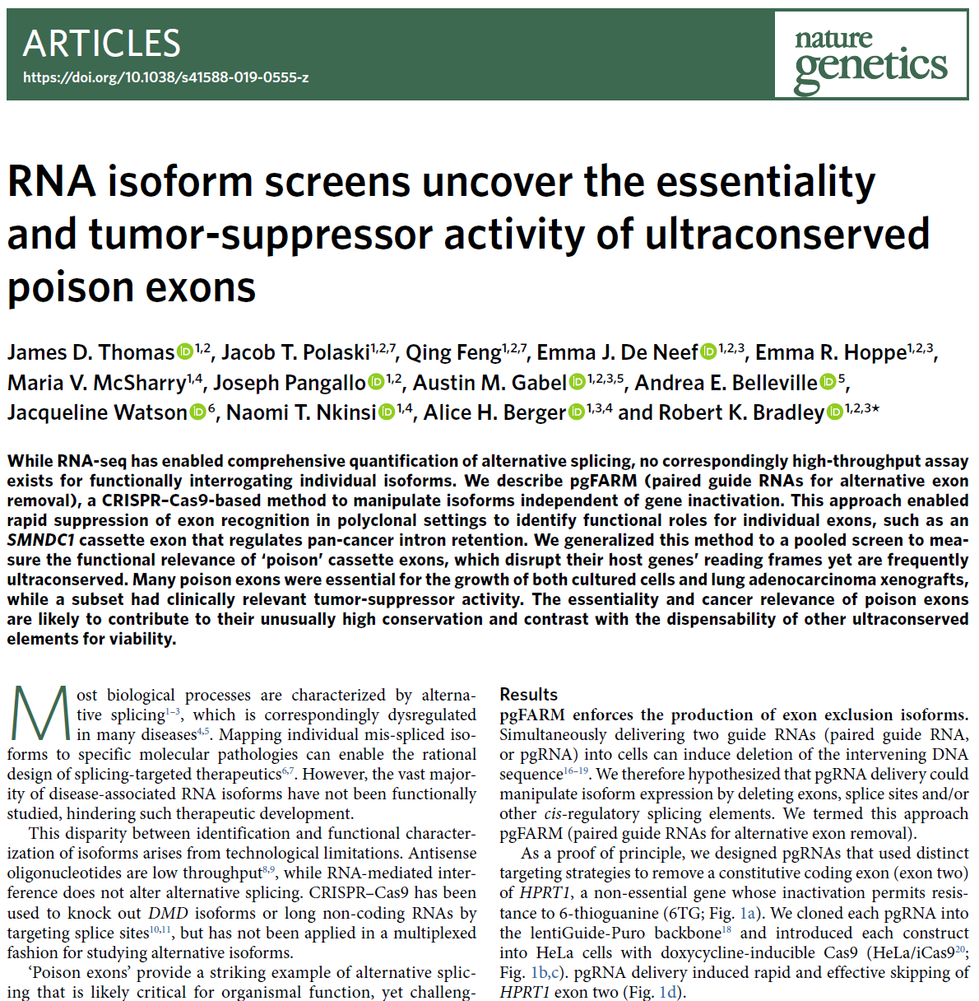
NMD analysis
Nonsense mediated decay is a cellular quality control mechanism to degrade transcripts with Premature Termination Codons (PTCs)
AS can:
Result in downstream frameshift, generating in-frame PTC
Alter PSI of exons harbouring an in-frame PTC (poison exons)
Literature reports on the conservation/regulation of poison exons seems to be valued
Our reporting:
Prediction of NMD candidates (based on assembled transcriptome)
Matching junctions/exons to NMD transcripts (by identifying NMD-transcript-specific exons/junctions)
Downstream analyses…
IN THIS STUDY: a complement of “cancer-essential exons” was identified using a modified CRISPR protocol to knock-out specific exons in HeLa

Slide 20
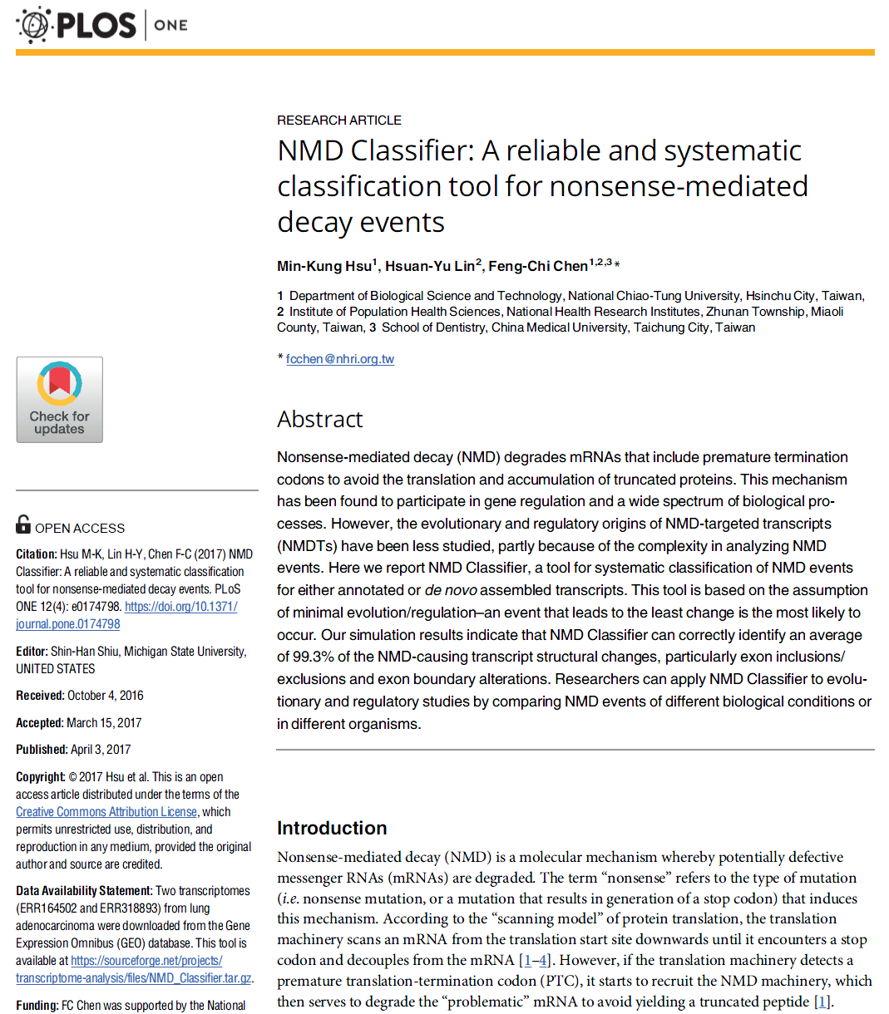
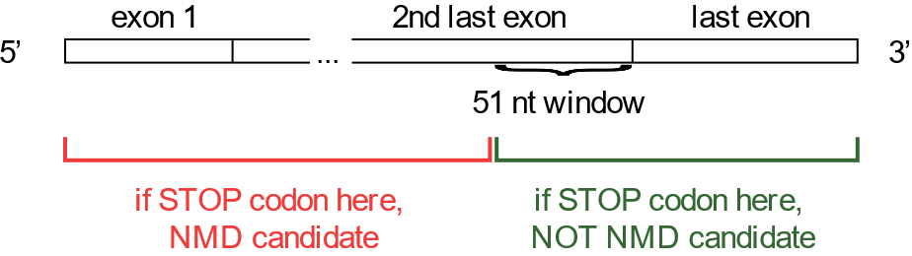
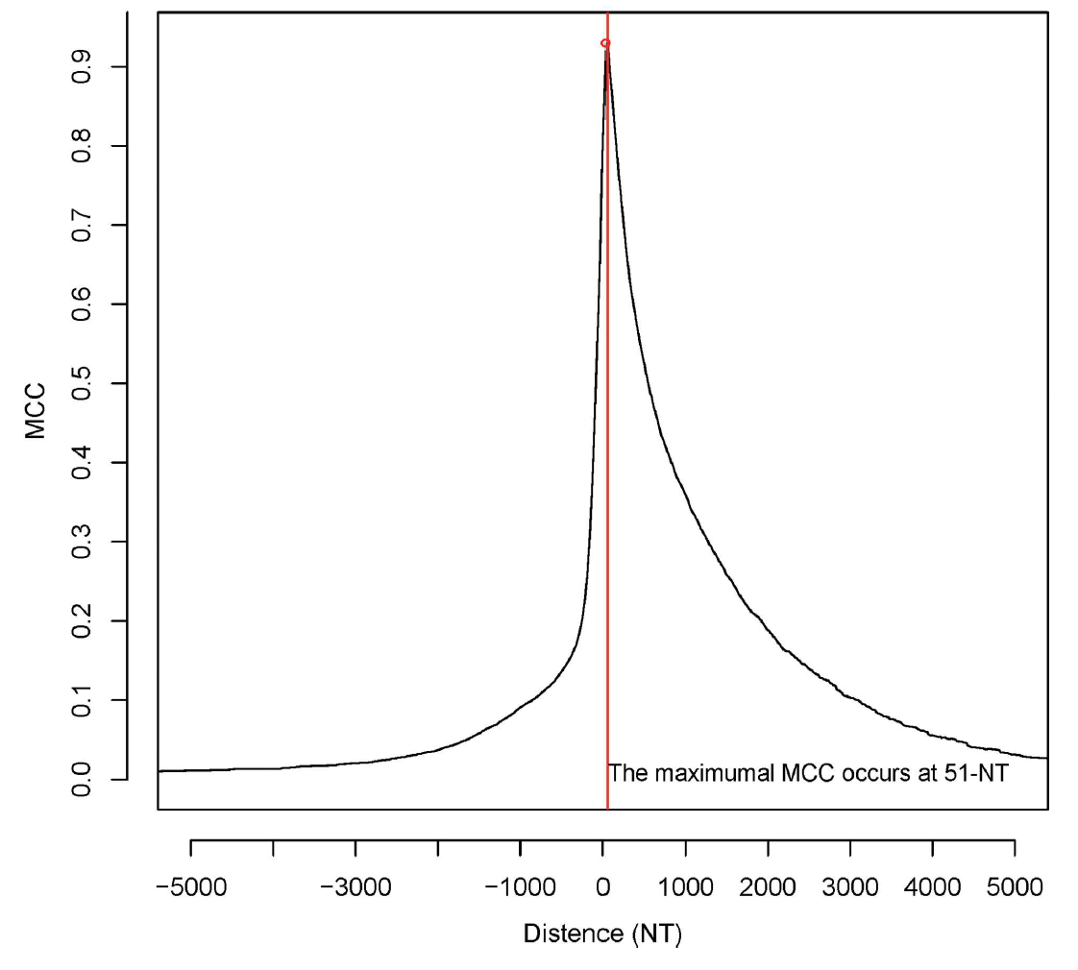
Predicting NMD candidates (de novo)
The last exon-exon junction is important
51nt seems to be the golden number (Hsu. et. al., 2017)
Their program didn’t work (seems to only take Cufflinks input). Therefore create my own.

Slide 21
Predicting NMD candidates (de novo)
51nt seems to be the golden number (Hsu. et. al., 2017)
Their program didn’t work (seems to only take Cufflinks input). Therefore create my own.
Method:
For each assembled transcript, do three-frame translation
Consider 51 nt window before the last exon-exon junction
If there is a stop codon in the window in ALL frames, then it’s an NMD candidate
Junctions/exons were matched to each transcript
Those which only matched to NMD transcripts are flagged as NMD junctions/exons.
The same condition for NMD junctions/exons was applied after matching against the reference annotation (Ensembl 38 v98)
The union of both sets of candidates were taken

Slide 22
NMD reporting* - PSI-Sigma
*For reference, the percent of transcripts which were annotated as NMD in the Ensembl reference ≈ 7%
There are 10.281% NMD exons overall.
There are 21.834% first exons overall.
There are 21.134% last exons overall.
There are 10.17% NMD exons constitutive.
There are 21.536% first exons constitutive.
There are 21.27% last exons constitutive.
There are 7.793% NMD exons differential.
There are 23.93% first exons differential.
There are 19.04% last exons differential.

Slide 23
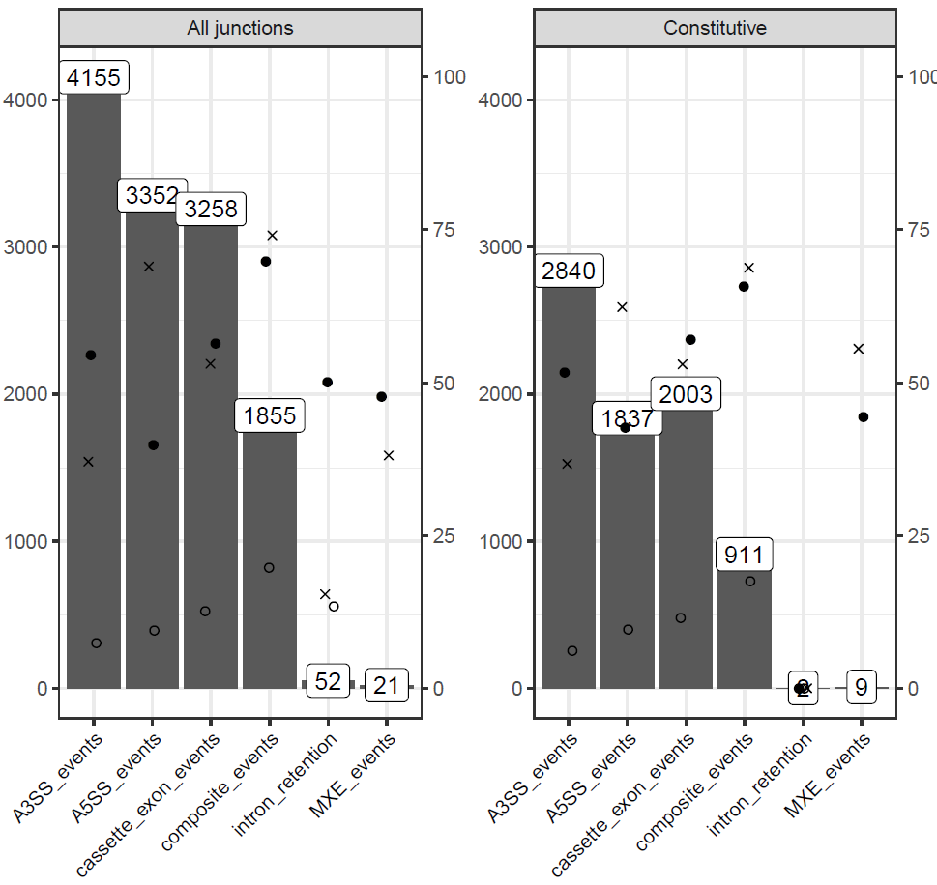
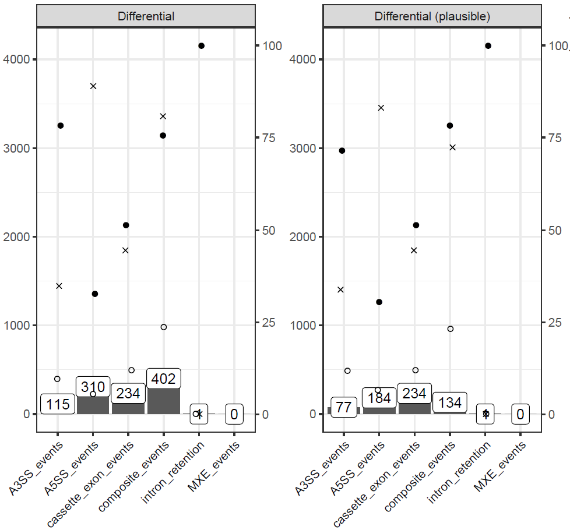
NMD reporting* - JUM
*For reference, the percent of transcripts which were annotated as NMD in the Ensembl reference ≈ 7%
There are 11.0533364846766% NMD junctions overall.
There are 54.9515480973765% first junctions overall.
There are 53.2813361695423% last junctions overall.
There are 9.7342804525125% NMD junctions constitutive.
There are 51.0786635096027% first junctions constitutive.
There are 52.5388055774796% last junctions constitutive.
There are 14.2184557438795% NMD exons differential.
There are 70.15065913371% first exons differential.
There are 58.0037664783427% last exons differential.
There are 12.6984126984127% NMD exons differential (plausible).
There are 60.3174603174603% first exons differential (plausible).
There are 53.4920634920635% last exons differential (plausible).

Slide 24
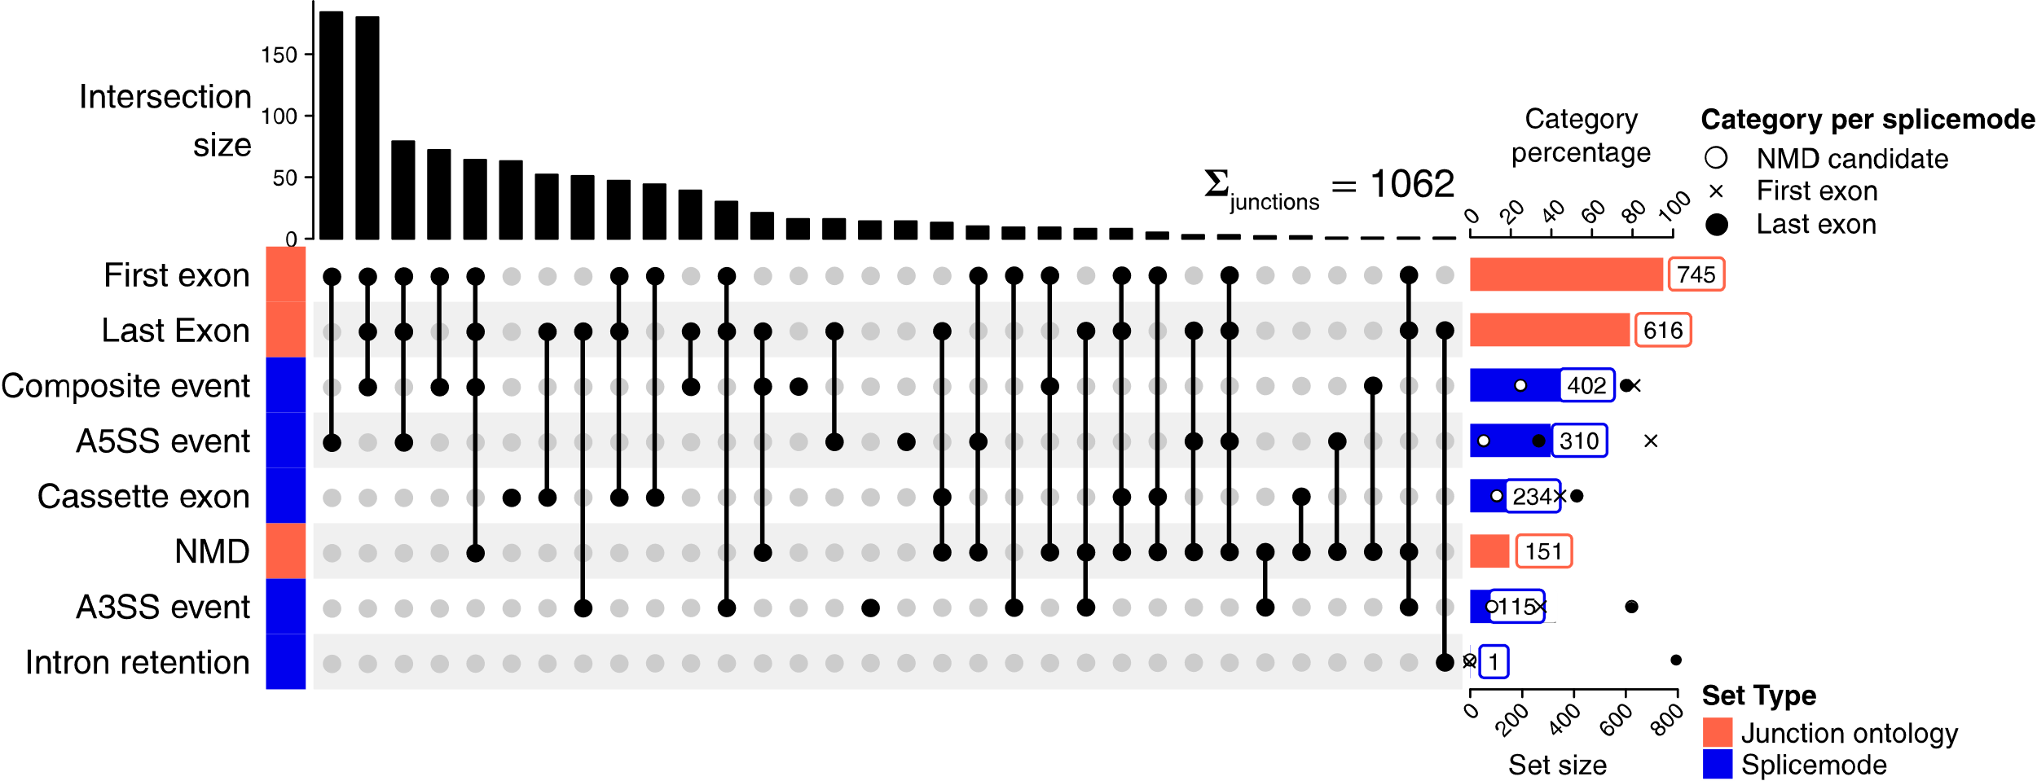
UpSet plot – differential junctions (JUM)
top causes of NMD
most likely locations of junctions and NMD
*For reference, the percent of transcripts which were annotated as NMD in the Ensembl reference ≈ 7%

